Slide 1


Chrome Apps
Web enhancement
Notes:
© SUPINFO International University - http://www.supinfo.com
SUPINFO vous permet de partager ce document
Vous êtes libre de :
Partager — reproduire, distribuer et communiquer ce document Remixer — modifier ce document
A condition de respecter les règles suivantes :
Indication obligatoire de la paternité — Vous devez obligatoirement préciser l’origine « SUPINFO » du document au début de celui-ci de la même manière qu’indiqué par SUPINFO International University – Notamment en laissant obligatoirement la première et la dernière page du document, mais pas d'une manière qui suggérerait que SUPINFO International University vous soutiennent ou approuvent votre utilisation du document, surtout si vous le modifiez. Dans ce dernier cas, il vous faudra obligatoirement supprimer le texte « SUPINFO Official Document » en tête de page et préciser notamment la page indiquant votre identité et les modifications principales apportées.
En dehors de ces dispositions, aucune autre modification de la première et de la dernière page du document n’est autorisée.
NOTE IMPORTANTE : Ce document est mis à disposition selon le contrat CC-BY-NC-SA Creative Commons disponible en ligne http://creativecommons.org/licenses ou par courrier postal à Creative Commons, 171 Second Street, Suite 300, San Francisco, California 94105, USA modifié en ce sens que la première et la dernière page du document ne peuvent être supprimées en cas de reproduction, distribution, communication ou modification. Vous pouvez donc reproduire, remixer, arranger et adapter ce document à des fins non commerciales tant que vous respectez les règles de paternité et que les nouveaux documents sont protégés selon des termes identiques. Les autorisations au-delà du champ de cette licence peuvent être obtenues à support@supinfo.com.
© SUPINFO International University – EDUCINVEST - Rue Ducale, 29 - 1000 Brussels Belgium . www.supinfo.com

Slide 2

Course objectives
Chrome Apps
By completing this course you will be able to:
Explain why apps are useful
Distinguish apps and extensions
Use CRX files and Chrome API
Develop a simple app

Slide 3


Course plan
Chrome Apps
What’s an app?
Apps structure
Manifest in depth
Chrome.* API

Slide 4

What’s an app?
Chrome Apps

Slide 5

Introduction
What’s an app?
Google’s famous browser has “plug-ins”
Piece of code enhancing native functionnalities
Three types:
Extensions
Hosted apps
Packaged apps
Gathered into a single place called the Chrome Web Store

Slide 6
Why extend Chrome?
What’s an app?
Can be useful to:
Override default interfaces
Provide one-click website access
Deliver games
…
Basically, everything softwares and webapps can do… But executed in Chrome!

Slide 7
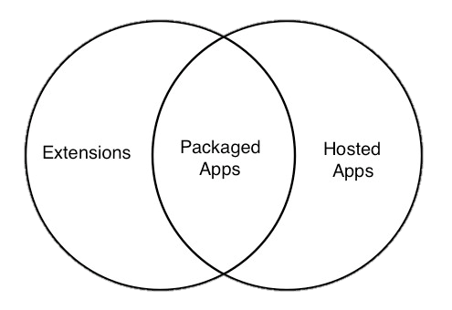
Three plug-ins types
What’s an app?
As said before, three “plug-ins types”:
Extensions
Hosted apps
Packaged apps
Obvisouly depends of what you need to do!
Notes:
https://developers.google.com/chrome/web-store/articles/apps_vs_extensions

Slide 8
Extensions
What’s an app?
Little or no UI component
Use of Chrome API
Achieving one very specific goal
Can be reachable on the toolbar

Slide 9

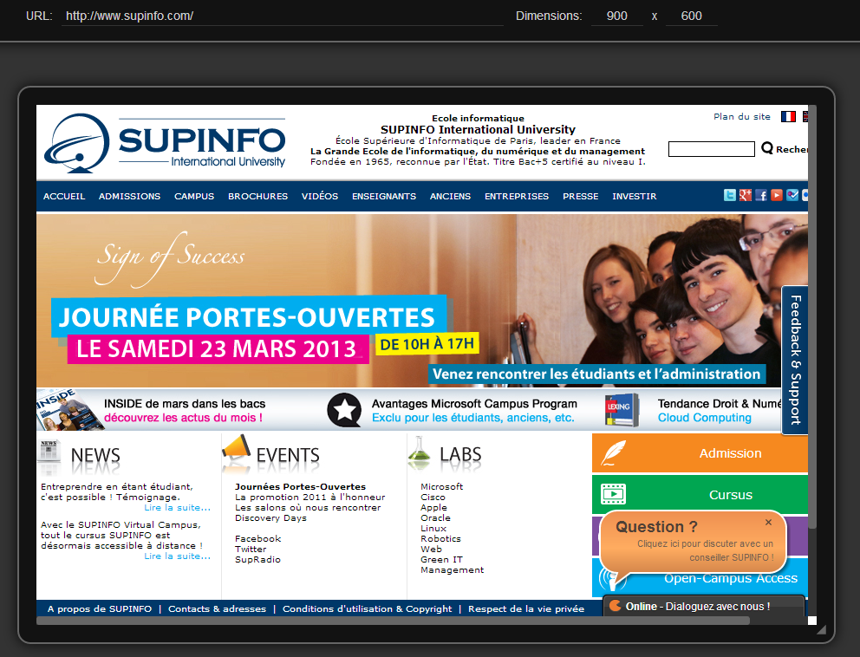
Extension example – Responsive Tester
What’s an app?
Notes:
https://chrome.google.com/webstore/detail/responsive-tester/apjlfpjacfkcckoimkbfhliehbkbnblm

Slide 10
Hosted apps
What’s an app?
Designed to be large width UI
Can work in all recent web browsers
Have no size limit
More secure as logic stays on server-side
Can be securely sold with the Licensing API
Notes:
Licensing API: https://developers.google.com/chrome/web-store/docs/check_for_payment

Slide 11
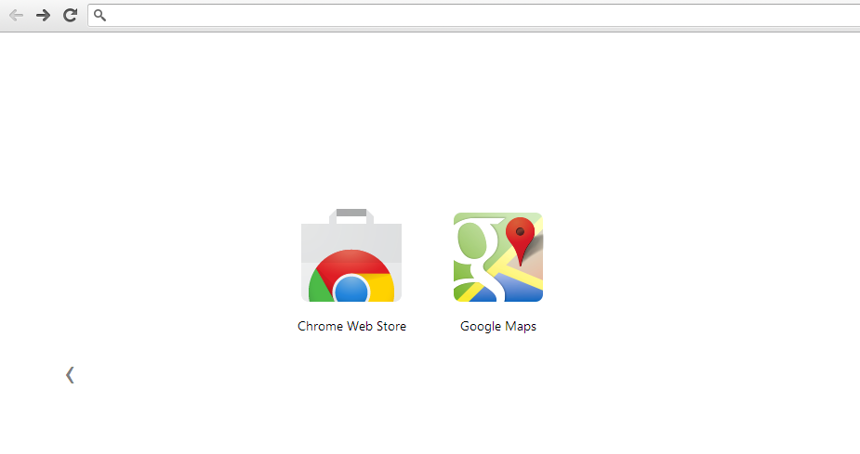
Hosted app example – Google Maps
What’s an app?
Notes:
Clicking on this app will launch http://maps.google.com in a new tab

Slide 12
Packaged apps
What’s an app?
No need for internet access at all
Stored on the user hard drive
Can run as a background service
Kind of missing link between the two others:
Use of Chrome API as extensions
Same look-and-feel as hosted apps

Slide 13
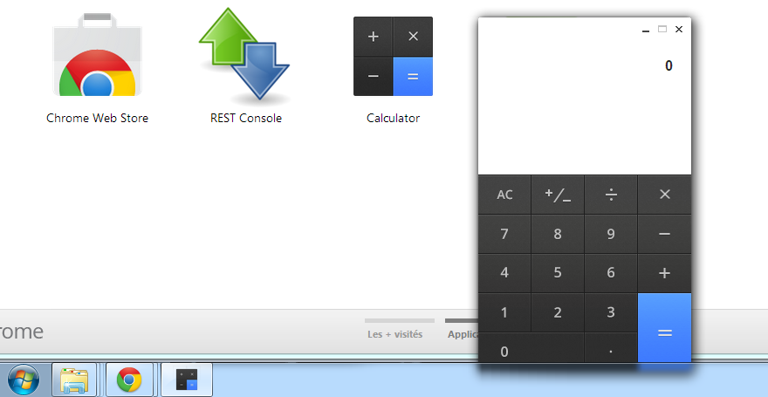
Packaged app example – Calculator
What’s an app?
Notes:
Clicking on Calculator app will launch the calculator in a new window, with an unique icon (as classic software)
Be careful, this opening way is not held by packaged apps: hosted apps can do this too

Slide 14
One app to rule them all
What’s an app?
Different systems for different uses
Choose wisely what you want to do
This flowchart can help you:
https://developers.google.com/chrome/web-store/docs/choosing

Slide 15
Technical informations
What’s an app?
These three are designed with web standards
Means HTML, CSS and JavaScript
Apps will mostly be launched with Webkit
Be careful to use Webkit supported APIs
We’ll see apps in this course, not extensions

Slide 16
Upload informations
What’s an app?
When your app is done, you can upload it to the Chrome Web Store
App must be valid regarding to Developer Program Policies
Mandatory to pay a 5$ fee for your first upload
Developer dashboard accessible at:
https://chrome.google.com/webstore/developer/dashboard
Notes:
Developer Program Policies: https://developers.google.com/chrome/web-store/program_policies

Slide 17


Questions ?

Slide 18

Apps structure
Chrome Apps

Slide 19
App basics
Apps Structure
App packaged in a *.crx file
Variation of ZIP file used by Chrome
Can be stored in the store or elsewhere
Must contain:
A manifest file (details about the app)
At least one icon is strongly recommended

Slide 20
App basics
Apps Structure
What might contain an app?
Manifest file required
Icons strongly recommended
HTML, JavaScript and CSS files
Embeddable objects (Flash/Silverlight/…)
Translation folders
…

Slide 21
Manifest file
Apps Structure
Must be called “manifest.json”
Contains informations like:
Texts: name, description, version…
Logic: page_action, permissions, app…
Some keys may depend on apps type
Be patient, we’ll see keys later in this course

Slide 22
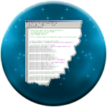
Manifest example (Hosted app)
Apps Structure
{
"name": "Google Maps",
"version": "3",
"icons": { "48": "icon48.png", "128": "icon128.png" },
"app": {
"urls": [
"http://maps.google.com/"
],
"launch": {
"web_url": "http://maps.google.com/"
}
},
"permissions": ["geolocation"],
"manifest_version": 2
}

Slide 23
Packaging app
Apps Structure
Chrome will package your apps
Tools → Extension panel
Must activate the “Developer mode”
In this tab, you can:
Load an unpacked extension
Development only, enable your app in Chrome
Pack extension
Create .crx file, and share your app with others!

Slide 24
Questions ?

Slide 25

Exercise (1/3)
Apps Structure
Now you can create a simple hosted app!
Let’s access to courses.supinfo.com easily
Download the Chrome latest version: https://www.google.com/intl/fr/chrome/browser/
Create a ‘SupinfoCourses’ folder somewhere

Slide 26
Exercise (2/3)
Apps Structure
Add a ‘manifest.json’ inside this folder
Copy the manifest example seen before
Modify it:
Change name, version and app properties
Remove permissions property
Keep icons and manifest_version properties

Slide 27
Exercise (3/3)
Apps Structure
Get icons at http://courses.supinfo.com/#3480
Load this unpacked extension in Chrome
Check if it works!
Chrome extensions tab didn’t warn you
Opening a new tab shows your new hosted app
Clicking on it redirects you at the right URL

Slide 28

Manifest in depth
Chrome Apps

Slide 29
Understanding manifest
Manifest in depth
Explains what your app should do:
Information directed to user:
Name
Description
Icons
…

Slide 30
Understanding manifest
Manifest in depth
Explains what your app should do:
Information directed to Chrome engine:
Manifest_version
Version
Permissions
…

Slide 31
Understanding manifest
Manifest in depth
Explains what your app should do:
Behavior executed by Chrome engine:
Locale
App
Minimum_chrome_version
…

Slide 32
Plenty of keys, now what?
Manifest in depth
Let’s see required properties:
Property | Type | Explanation
name | String | Your app name
version | String | Your app version (used for auto-updates)
manifest_version | Int | Must be equals to 2 (no quotes) at the moment
{ // Tiniest manifest file ever
"name": "My super app",
"version": "0.0.0.1",
"manifest_version": 2
}

Slide 33
Plenty of keys, now what?
Manifest in depth
Let’s see recommended properties:
Create needed folders before pointing default_locale, otherwise a warning is thrown
We’ll see later in this course for i18n
Property | Type | Explanation
description | String | Your app description
icons | Array | Key for the size (in px), value for the icon URL
default_locale | String | Used for internationalization

Slide 34
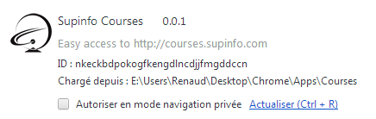
Manifest attributes
Manifest in depth
As shown in Tools → Extensions panel:
"name"
"version"
"description"
"icons"
Notes:
Clicking on this app will launch http://maps.google.com in a new tab

Slide 35
Plenty of keys, now what?
Manifest in depth
Let’s see some other properties:
Property | Type | Explanation
permissions | Array | Asks Chrome to gain privileges
content_security_policy | String | Specifies CSP for this app
key | String | Mandatory to publish on Web Store

Slide 36
Plenty of keys, now what?
Manifest in depth
With these attributes, you can register ‘something’…
Is it an app? No, nothing is shown on the dashboard
Is it an extension? No, zero icon at top-right corner
Actually, it’s nothing usable
What defines an app?
The property ‘app’ in the manifest of course!

Slide 37
Hosted app or Packaged app?
Manifest in depth
The ‘app’ property is common for these two
But inside, it’s completely different!
Let’s see first for hosted app
As our wondeful Courses example
We’ll see after for packaged app!

Slide 38
The ‘app’ property – Hosted apps
Manifest in depth
A JSON property containing:
Property | Type | Explanation
urls | Array | Pages of the hosted app (wildcards accepted)
launch web_url container height width | JSON String Enum Int Int | What we do at app launch URL accessed "panel" opens app out of the box "tab" opens app in a new tab Height of app (only for panel container) Width of app (only for panel container)

Slide 39

Manifest example (Hosted app)
Manifest in depth
{
"name": "Google Maps",
"version": "3",
"icons": { "48": "icon48.png", "128": "icon128.png" },
"app": {
"urls": [
"http://maps.google.com/"
],
"launch": {
"web_url": "http://maps.google.com/"
}
},
"permissions": ["geolocation"],
"manifest_version": 2
}

Slide 40
Packaged apps
Manifest in depth
Packaged apps contains all processing
As a result, it’s not a web URL…
It’s a relative link to a JavaScript file
You can’t register an HTML file for these apps
Create window with the Chrome API in JavaScript

Slide 41
The ‘app’ property – Packaged apps
Manifest in depth
A JSON property containing:
Property | Type | Explanation
background scripts | JSON Array | What we do while app is active Which scripts to load at first
// ...
"app": {
"background": ["background.js"] // Load it!
}
// ...

Slide 42
Background scripts
Manifest in depth
background property works well…
But how to use Chrome with this script?
All packaged apps logic stays in JavaScript
Even which HTML page to show
This is done through Chrome APIs

Slide 43
Questions ?

Slide 44
Chrome.* api
Chrome Apps

Slide 45
Overview
Chrome.* API
Chrome API is a set of JavaScript functions understood by the browser
Ability to interact with plenty of features:
Debugger
Downloads
History
…

Slide 46
Overview
Chrome.* API
JavaScript only, of course!
Accessible via the ‘chrome’ global variable
Incompatible with hosted apps
Contains many attributes and methods
We’ll see only some key features

Slide 47
Chrome.app.*
Chrome.* API
Contains all apps-related objects and methods
Two objects defined inside:
Runtime
Window

Slide 48
Chrome.app.runtime.*
Chrome.* API
Useful to manage app lifecycle
Contains two overridable events:
onLaunched
onRestarted
Use the function addListener to use them

Slide 49
App lifecycle
Chrome.* API
Event page loaded
onLaunch()
App use
No windows open
onSuspend()
Notes:
https://developer.chrome.com/apps/app_lifecycle.html

Slide 50
Overriding events
Chrome.* API
Startup handling example:
chrome.app.runtime.onLaunched.addListener(function() {
launchMyApp(false);
});
chrome.app.runtime.onRestarted.addListener(function() {
launchMyApp(true);
});
function launchMyApp(isResumed) {
// Load things if isResumed is set to true
// Do something
}

Slide 51
Chrome.app.window.*
Chrome.* API
Useful to handle your app window
We’ll see the method:
create(file, arguments, callback)
Ability to open one or more windows

Slide 52
Opening a window
Chrome.* API
Useful at your packaged app startup:
chrome.app.runtime.onLaunched.addListener(function() {
chrome.app.window.create('main.html', {
width: 800,
height: 600,
minWidth: 800,
minHeight: 600
},
function(window_created) {
console.log(window_created)
});
});

Slide 53
Other APIs
Chrome.* API
Chrome.app is sufficient to handle your app
Let’s interact a little more with browser!
We’ll see the following APIs:
chrome.storage
chrome.bookmarks
chrome.i18n

Slide 54
Chrome.storage
Chrome.* API
Access browser local storage
Can also use Chrome sync
Need permission ‘storage’ in manifest
You can also ask for ‘unlimitedStorage’
Store data to persist state
Notes:
https://developer.chrome.com/extensions/storage.html

Slide 55
Chrome.storage example
Chrome.* API
// ...
function saveChanges() {
var text = document.getElementById("myTextarea").value;
chrome.storage.local.set({ myTextareaValue: text });
}
function getValue() {
var text = chrome.storage.local.get("myTextAreaValue");
// Do something with it!
}
// ...
Notes:
https://developer.chrome.com/extensions/storage.html

Slide 56
Chrome.bookmarks
Chrome.* API
Access browser bookmarks
Make CRUD on both folders and links
Need permission ‘bookmarks’ in manifest
Notes:
https://developer.chrome.com/extensions/bookmarks.html

Slide 57
Chrome.bookmarks main methods
Chrome.* API
create(args, callback)
Add a folder or a link
getTree(callback)
Returns the entire tree
search(query, callback)
Returns matched elements
Notes:
https://developer.chrome.com/extensions/bookmarks.html

Slide 58
Chrome.bookmarks example (1/2)
Chrome.* API
var folderId;
// Create a bookmark folder at root (no URL)
chrome.bookmarks.create(
{'title': 'A Bookmark Folder'},
function(newFolder) {
folderId = newFolder.id;
});
// Create a bookmark inside previously created folder (parentId)
chrome.bookmarks.create(
{'parentId': folderId,
'title': 'My super bookmark',
'url': 'http://www.google.com/' }
);
Notes:
https://developer.chrome.com/extensions/bookmarks.html

Slide 59
Chrome.bookmarks example (2/2)
Chrome.* API
// Returns all 0-depth bookmarks and log their title
chrome.bookmarks.getTree(function(items) {
showTitles(items[0].children); // Topbar bookmarks
});
// Search query in all BookmarkTreeNodes properties
chrome.bookmarks.search("Google", function(items) {
showTitles(items);
});
function showTitles(bookmarks) {
for(var i = 0; i < items.length; i++) {
// items[i] is a BookmarkTreeNode object
console.log(items[i].title);
}
}
Notes:
https://developer.chrome.com/extensions/bookmarks.html

Slide 60
Chrome.i18n
Chrome.* API
Internationalize your app!
Must do a few things to make it work:
Define ‘default_locale’ in manifest
Create folder ‘_locales’ at root app
Create a folder for each locale code (‘en’, ‘it’, ‘ko’…)
Add in each a file called ‘messages.json’
Notes:
https://developer.chrome.com/extensions/i18n.html

Slide 61
Chrome.i18n
Chrome.* API
Directory structure example:
manifest.json
Extension
directory
*.html, *.js
en
messages.json
_locales
es
messages.json
ko
messages.json
Notes:
https://developer.chrome.com/extensions/i18n.html

Slide 62
Chrome.i18n
Chrome.* API
‘messages.json’ uses valid JSON syntax
At root, define the string property as a key
Contains another JSON with two properties:
message: The actual translation
description: A facultative string to help translators, describing in which context this message is used
Notes:
https://developer.chrome.com/extensions/i18n.html

Slide 63
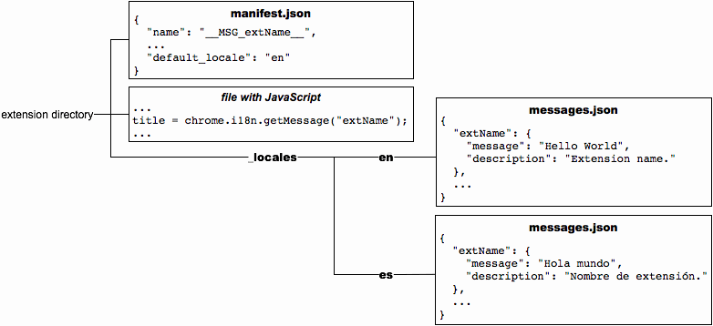
Structure of ‘messages.json’ files
Chrome.* API
Notes:
https://developer.chrome.com/extensions/i18n.html

Slide 64
Questions ?

Slide 65
Exercise
Chrome.* API
Création d’une calculatrice ou quelque chose du genre (durée 30min)

Slide 66

The end
Chrome Apps
Thanks for your attention

